Slide 1
Data Structures and Liquidity
Class 3 | 22 June 2024
Electronic Health Records and Data Structures
Stephen Blackwelder, PhD

Slide 2
Welcome Back!
Questions or Concerns?

Slide 3
Course Topic Outline
Getting Data In
EHRs and Clinical Records
Origin and relevant history of the medical record; contemporary promise and problems
Clinical Decision Support
Uses of medical record data to drive patient care
Storing, Finding, Retrieving
Data Structures and Liquidity
Relational database structures and effective use of EHR data
Data Curation
Raw data, refined data, and patient data from non-EHR sources
Turning Data into Insight
Analytics Leadership
Organization structure and politics of EHR data analysis
Getting from Data to Value
Approaches and techniques for turning clinical data into decisions

Slide 4
Course Topic Outline
Getting Data In
EHRs and Clinical Records
Origin and relevant history of the medical record; contemporary promise and problems
Clinical Decision Support
Uses of medical record data to drive patient care
Storing, Finding, Retrieving
Data Structures and Liquidity
Relational database structures and effective use of EHR data
Data Curation
Raw data, refined data, and patient data from non-EHR sources
Turning Data into Insight
Leading Innovation
Analytics strategy in healthcare organizations
Systemic Analytical Decision Making
Designing an environment compatible with data-driven decision making

Slide 5
Individual Essay
Submit an essay of between 1,000 and 1,200 words, depicting your side of a conversation about a healthcare analytics topic, in the spirit of the following scenario. You are at the health system where you work as a clinician and you find yourself in the break room or on an elevator with one of the leadership team, who have just learned of your promotion to a mid-level analytics leadership role. Interested to gauge your acumen and get to know you better, they ask a question or make a comment and look to you expectantly. You have about six minutes to get your point across to them, advocating for the solution or approach you believe is most relevant.
Topics to be selected from material covered thus far
Due July 4th; 20% of final grade

Slide 6
Individual Essay – What’s the Goal?
Rubric—don’t dive in without it!
Clearly articulated argument for or against a specific concrete approach or solution, delivered as well-scripted monologue, without grammatical errors
Demonstrates a strong and accurate understanding of the concepts, which are well-chosen and convincingly employed to make the argument's point
Argues persuasively using evidence from course material and discussion
Essay is at least 1000 words but not more than 1200, and was submitted before the deadline

Slide 7
Team Data Analytics Project
Dataset will be provided
Due July 31st; 30% of final grade
Teams will share or divide up among yourselves these “research project” tasks:
Research question identification
Study design
Data management
Data analysis
Written Findings (2-5 pages)
Step 1: Determine “research” question
Step 2: Examine data dictionary to identify useful variables to include

Slide 8
Data Structures and Liquidity
Class 3 / Week 5
Relational database structures and effective use of EHR data; introduction to types of healthcare data

Slide 9
Class 3 Learning Objectives
Understand the importance of knowing the research question prior to beginning to work with the data.
Be able to explain the difference between retrospective and prospective studies, what an IRB is, and how participant consent affects how data can be used.
Understand common database terms: variable, observation, table..
Understand important database concepts: keys, JOINs, and filtering in queries.
Be able to articulate three benefits of an enterprise data dictionary.

Slide 10
Class 3 Topic Outline
I: Research and Retrospective Uses of PHI
II: Relational Database Structure

Slide 11
Research Uses of EHR Data
Typical Research Uses of EHR
Real-World Evidence and Retrospective Studies
What’s the Role of IRB in Use of EHR Data?
Quality Improvement Studies vs RCT
When is an IRB approval required?
Treatment, Payment, Operations
What are Business Associates?
Does HIPAA Privacy Rule allow licensing of EHR data to third parties?

Slide 12
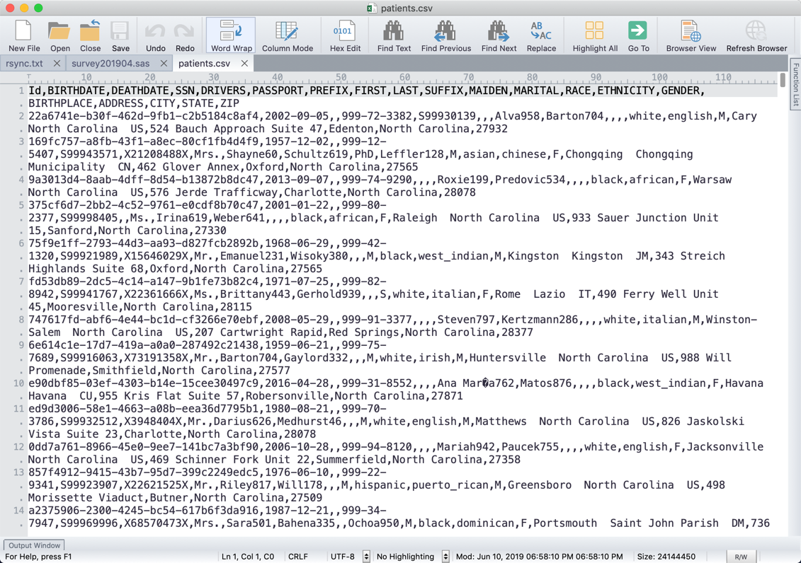

Slide 13
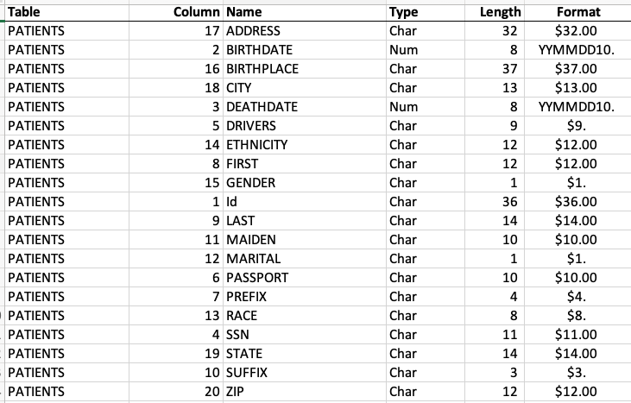
Data Dictionary

Slide 14
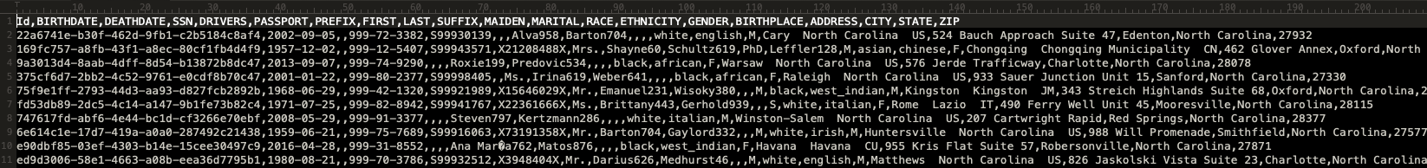
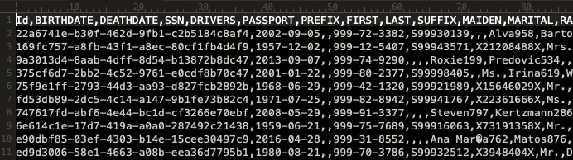
Comma-Separated Values (.csv) Format

Slide 15
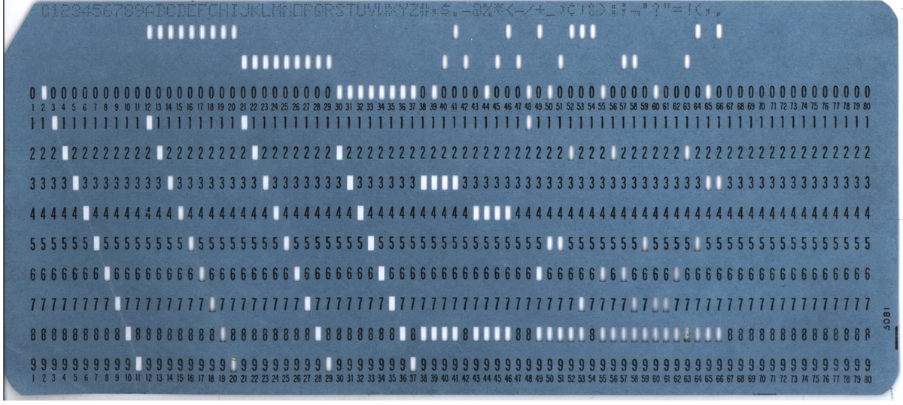
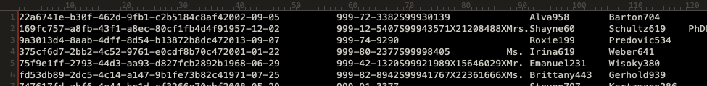
Fixed-Width Columns Format
1 20 40
1-36: ID
77-86: Passport Number (##########)
37-46: Birthdate (YYYY-MM-DD)
87-90: Prefix (####)
47-56: Deathdate (YYYY-MM-DD)
91-104: First Name (##############)
57-67: Social Security Number ($$$-$$-$$$$)
105-118: Last Name (##############)
68-76: Driver License Number (#########)
119-121: Prefix (###)

Slide 16
Fixed-Width Columns Format
1 20 40
1-36: ID
77-86: Passport Number (##########)
37-46: Birthdate (YYYY-MM-DD)
87-90: Prefix (####)
47-56: Deathdate (YYYY-MM-DD)
91-104: First Name (##############)
57-67: Social Security Number ($$$-$$-$$$$)
105-118: Last Name (##############)
68-76: Driver License Number (#########)
119-121: Prefix (###)

Slide 17
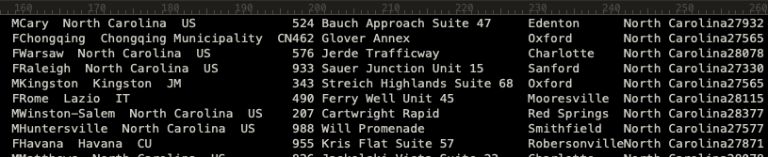
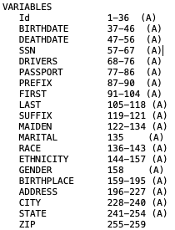
Column Specification

Slide 18
Star Schema Data Model
 | Fact Tables | Dimension Tables
Purpose | Contain related business measures. | Represent the objects of the business.
Data | Most often numeric. | Textual and discrete.
Size | Built from the lowest grain. Narrow but large. | Many columns but few rows. Wide but short.
Keys | Accessed via dimension tables. | Each has a single Primary Key but often employ surrogate keys.
Etc. | Very efficient. | Often the “by” word in a query.
Notes:
Many areas can share dimensions, “conformed dimensions”, improves efficiency.

Slide 19
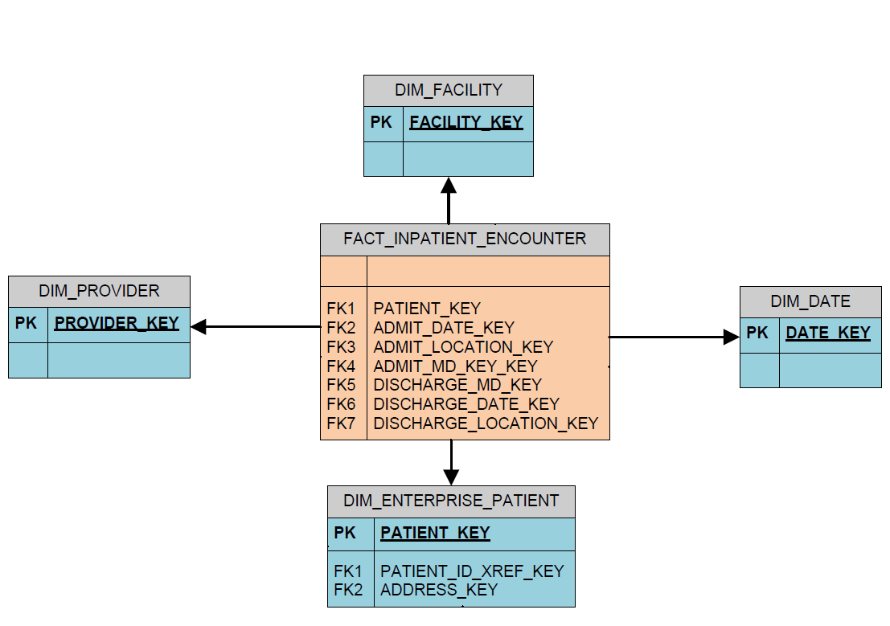
Star Schema Visual Representation
DIMENSION
FACT
DIMENSION
DIMENSION
DIMENSION

Slide 20
Questions from Class Members
Is AI actually intelligent?
How long should a query pulling health data take to run?
Does moving to the cloud reduce the time it takes?
How do pharma companies obtain EHR data?

